Slide 1

SkillMatch Pro: Intelligent Resume Insights
Team: Data Draculas
Anvesh kumar Nallala – 16325915
Hemanth Venkata sai Gontla – 16332137
Deva Sri Sasikala Mettela – 16331102
Vamshi Maragoni - 16325850

Slide 2

Introduction
The objective of our application is to help job seekers analyze their resumes and get insights on their chances of getting shortlisted for a job.

Slide 3
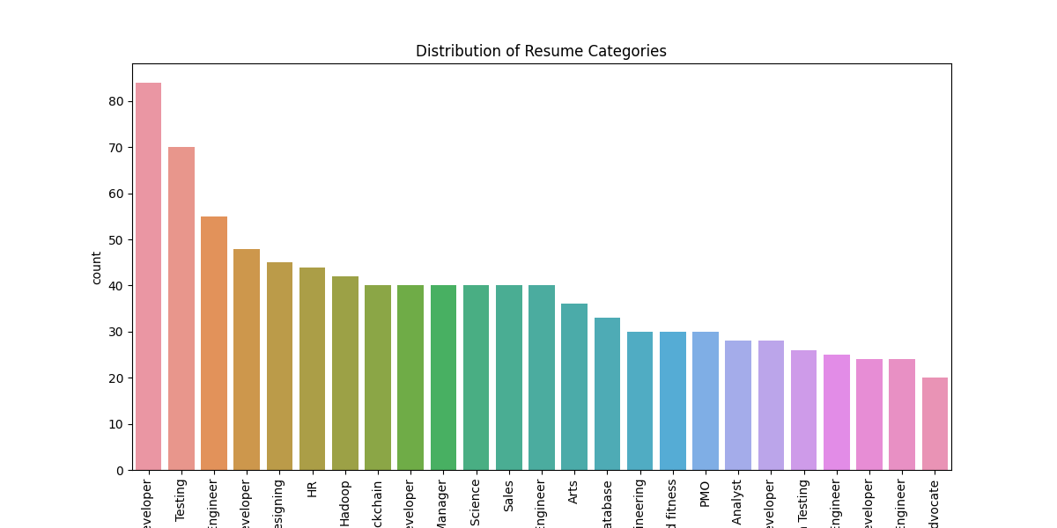

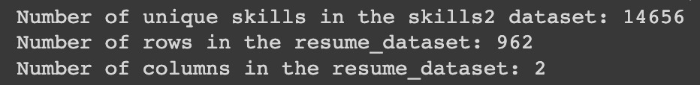
Dataset and Libraries
Dataset: Resume dataset and skill
dataset
Libraries used: Flask, pandas, numpy, matplotlib, seaborn, scikit-learn, PyPDF2, and re

Slide 4

Data Preprocessing
Cleaning resume text:
Remove URLs, RT, cc, hashtags, mentions,special characters and twitter handles.
Replace non-ASCII characters with space.
Collapse multiple spaces into a single space.
Label encoding for categorical variables.
Train-test split (75% train, 25% test).

Slide 5

Feature Extraction and Model Training
TfidfVectorizer is used to extract features from text data by creating a vocabulary of words and computing the TF-IDF score for each word in each document.

Slide 6

Logistic Regression
Logistic regression is used to predict resume categories based on features extracted using TF-IDF vectorization.
TfidfVectorizer is applied for feature extraction, and Logistic Regression is applied to predict the category.

Slide 7
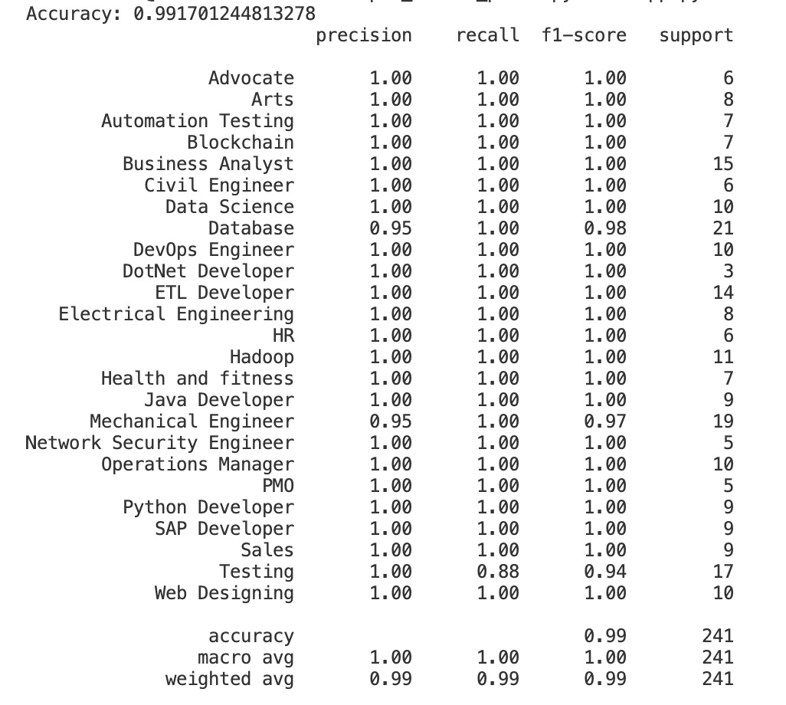
Model Evaluation
Accuracy score
Classification report

Slide 8

Extracting Top Skills per Category
Show top skills for each category along with their importance
Use the pipeline, category ID, and skills set to get the top skills

Slide 9
IDENTIFYING CATGEORY
TFID vectorizer converts the text data into a matrix of TF-IDF features.
The Logistic Regression model then learns the relationship between these features and the target variable (resume categories).

Slide 10

Missing Skills Calculation
Calculate missing skills by comparing top skills for the predicted category with the skills mentioned in the resume

Slide 11

Shortlisting Chances Calculation
Calculate the chances of getting shortlisted based on missing skills and their importance

Slide 12
Web Application
Flask web application
Routes: index and analyze
Upload PDF resumes for analysis
HTML form for uploading resumes
jQuery for handling form submission and AJAX request to the analyze route
Display results: predicted category, top skills, resume skills, missing skills, and shortlisting chances

Slide 13

Conclusion
Achievements: Accurate resume analysis with valuable insights for the user
Future improvements: Enhancing the accuracy and efficiency of the machine learning model used for matching candidates and jobs.
Expanding the range of file formats that can be uploaded and processed by the system.
Including additional job categories and skills to better match the diverse needs of employers and job seekers.

